Slide 1
Medieval Art
Migration Period
300ce -900ce
Gothic
1140ce-1500ce
Early Christian
100ce-500ce
Insular Art
600 - 1100 ce
Romanesque
1000ce-1150ce
Early Renaissance
1400ce
These (above the timeline) are the specific art periods we are going to study
100 200 300 400 500 600 700 800 900 1000 1100 1200 1300 1400
Byzantine and the spread of Islam
476 ce – 1453 ce
Middle Ages
500 ce -1400ce
Early Medieval
200 ce – 1000 ce
Iconoclasm
726ce – 843ce
These are broad historic terms to describe this very large time period.

Slide 2
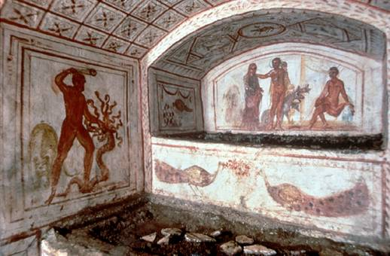
Early Christian Art
Examples of early Christian fresco painting can be found in underground tombs, such as the catacombs on Via Latina in Rome, shown here. Early Christian artists borrowed motifs from Roman mythology and gave them Christian significance. The figure of Hercules killing the serpent, on the left, came to symbolize Jesus Christ triumphing over Satan. The peacocks on the tomb stand for resurrection because of a belief that their flesh does not decay after death.
G. Neri/Woodfin Camp and Associates, Inc.
encarta.msn.com/.../pho/t065/T065226A.jpg

Slide 3
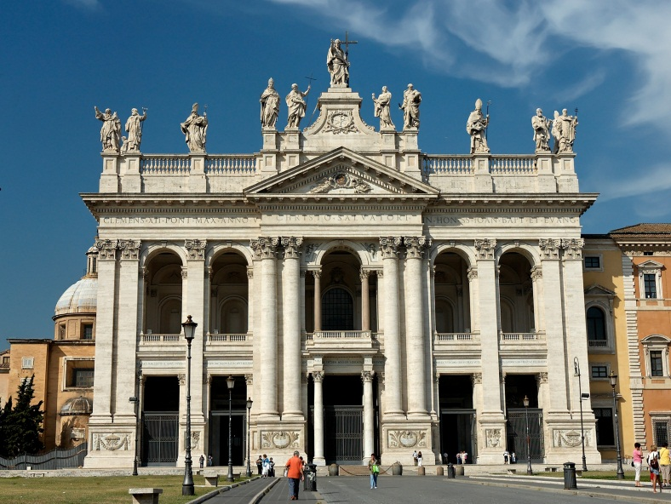
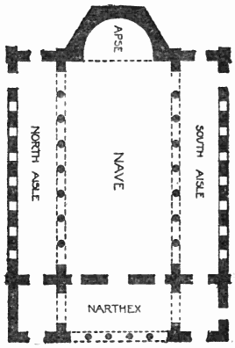
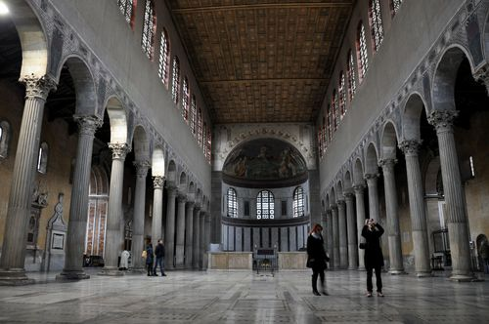
This is the floor plan of a basilica. It first was used as a public meeting place in Rome but later used for religious purposes. Most churches are based on some variation of this floor plan.

Slide 4
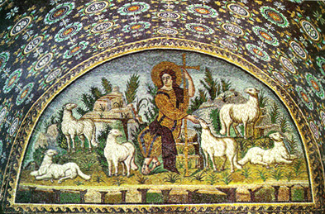
"Christ as the Good Shepherd," mosaic from the mausoleum of Galla Placidia, c.425-450. Some devices of Roman illusionism are still being used -- shadows, tonality of forms, spatial depth.

Slide 5
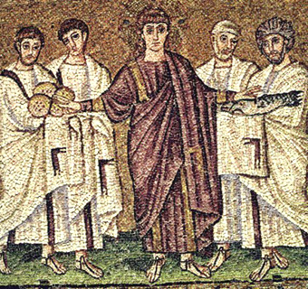
 | The mosaic to the left, the "Miracle of the Loaves and the Fishes," from the Church of Sant'Apollinare Nuovo. c.504. Compare the stylistic change from Galla Placidia -- Jesus wears the Imperial purple robe; the dimension is more shallow; the gold background appears as a 'screen'; and there are fewer references to the physical world.

Slide 6
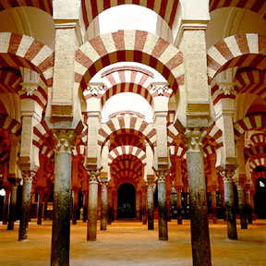
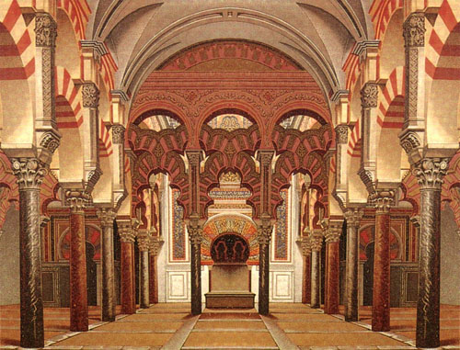
The Spread of Islam
Mosque of Cordoba
Spain

Slide 7
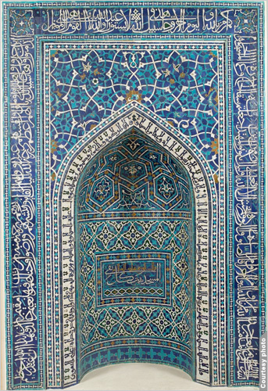
Mihrab (prayer niche), Ilkhanid period (1206–1353), a.h. 755 / a.d. 1354–55 Iran, Isfahan Mosaic of polychrome-glazed cut tiles on stonepaste body; set into mortar

Slide 8
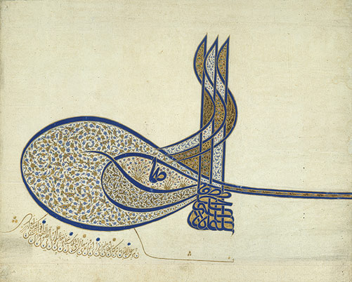
Tughra (Imperial Cipher) of Sultan Süleyman the Magnificent (r. 1520–1566), ca. 1555; Ottoman Turkey (Istanbul) Ink, opaque watercolors, and gold on paper 20 1/2 x 25 3/8 in. (52.1 x 64.5 cm)
The Ottoman tughra is a calligraphic emblem of the sultan's authority that was included in all official documents

Slide 9
Byzantine Art
Rome in the East: The Art of Byzantium Royal, Luxurious, Heavenly, and Spiritual
The art of the Eastern Roman Empire, the Christian empire whose capital was Constantinople (now known as Istanbul), which endured from c. 330 CE following the Roman Empire in the east, until it was conquered by the Turks c.1450.
The term, however, refers more to a style associated with Byzantium than to its area. Byzantine paintings and mosaics are characterized by a rich use of color and figures which seem flat and stiff. The figures also tend to appear to be floating, and to have large eyes. Backgrounds tend to be solidly golden or toned. Intended as religious lessons, they were presented clearly and simply in order to be easily learned. Early Byzantine art is often called "Early Christian art."
Byzantine architects favored the central plan covered by a huge dome.
Making generalizations about the visual culture of any group of people is a crude endeavor, especially with a culture as diverse as Byzantium's.
http://www.artlex.com/

Slide 10
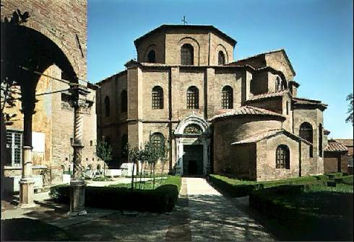
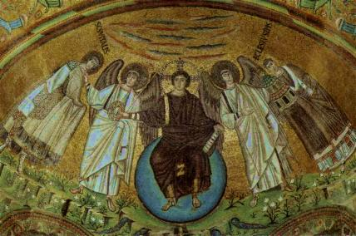
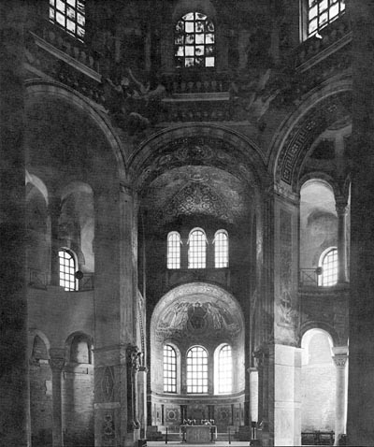
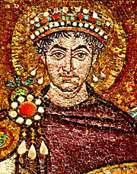
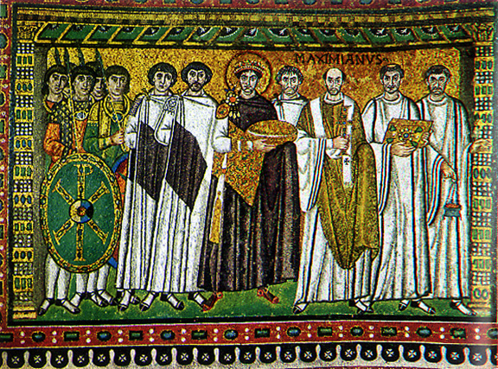
The Church of San Vitale, Ravenna, 530-547CE

Slide 11
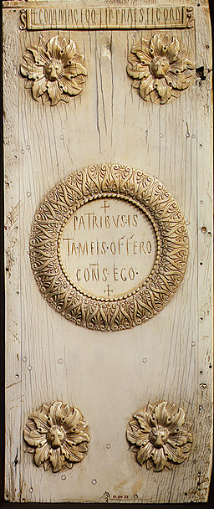
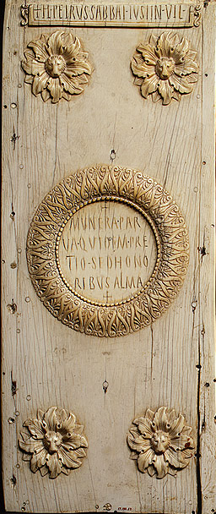
Diptych of the Consul Justinian,
521 Byzantine; Made in Constantinople

Slide 12
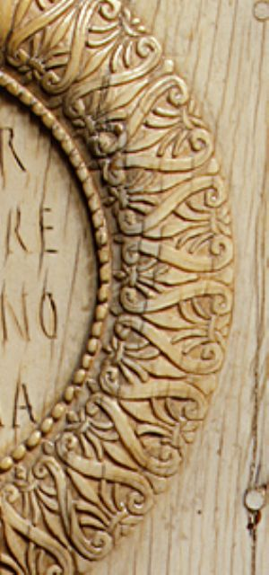
Justinian, who would be the greatest emperor of the early Byzantine period, presented these handsome ivory panels to a member of the Roman senate announcing his election as consul. The title, now largely honorific, was once that of the supreme magistrate of the Roman Republic. Once hinged together with the names of the other consuls inscribed in wax on the interior, they were probably presented as an invitation to the great public games that the new consuls hosted in Constantinople's hippodrome (stadium). The elegantly carved classical motifs focus attention on the inscriptions written in Latin, still the official language of the Empire. Justinian was appointed consul for the East in 521, six years before he became emperor. To celebrate his appointment, he had diptychs, including this one, made for presentation to members of the Senate. Such ivory diptychs were popular in the early Byzantine Empire.
This refined, simply carved example announces Justinian's appointment in Latin at the top of each wing, with a running inscription addressed to the senators in an elaborately bordered medallion in the center of each wing. At the four corners of each wing, lions' heads emerge from the centers of lush acanthus leaves. The soft, tactile quality of the acanthus stands in marked contrast to the abstract decorative medallions. In comparison with other consular diptychs, this example is relatively plain, since it was given to members of the Senate: higher government officials would have received more elaborately carved examples. The fact that three such diptychs presented by Justinian survive is certainly due to the subsequent political importance of the man whose consulship they proclaim.

Slide 13
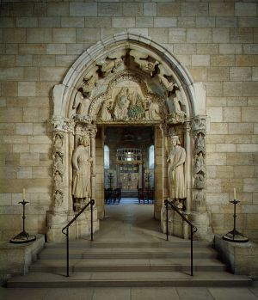
The tympanum above the doorway depicts Christ crowning the Virgin as the Queen of Heaven. This portal, probably from the north aisle of the cloister, would have led from the monastic precinct into the abbey church. The portal suffered severe damage during the sixteenth-century Wars of Religion; the heads of the two kings may have been repaired in the seventeenth century.
Doorway from Moutiers-Saint-Jean, ca. 1250 French; Made in Burgundy White oolitic limestone with traces of polychromy; 15 ft. 5 in. x 12 ft. 7 in.

Slide 14
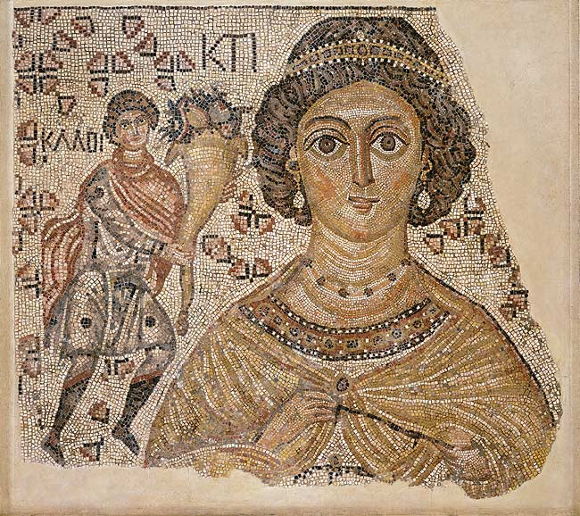
The bust of a richly bejeweled woman stares from this fragment of a floor mosaic that was once part of a large public building. The partially restored Greek inscription near her head identifies her as Ktisis, the personification of the act of generous donation or foundation. To emphasize her role as donor, she holds the measuring tool for the Roman foot. On her right a man extends a cornucopia toward her as if offering a gift; the Greek word for "good" is near his head. Originally a similar figure probably appeared to her left, and an inscription by his head would have completed the legend "Good wishes."
Fragment of a Floor Mosaic with a Personification of Ktisis,
500–550 Byzantine Marble and glass; Overall 53 3/8 x 33 in.
www.metmuseum.org

Slide 15
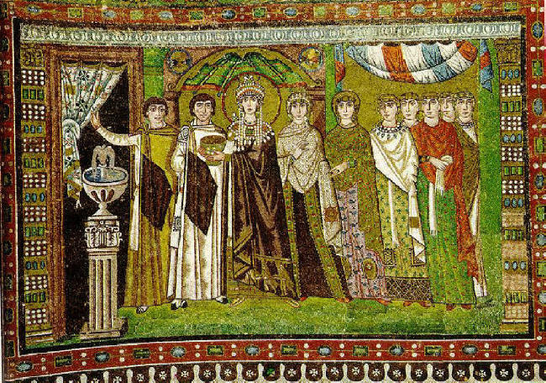
Portrait Mosaic of Theodora, Church of San Vitale, Ravenna, Italy, c.530CE

Slide 16
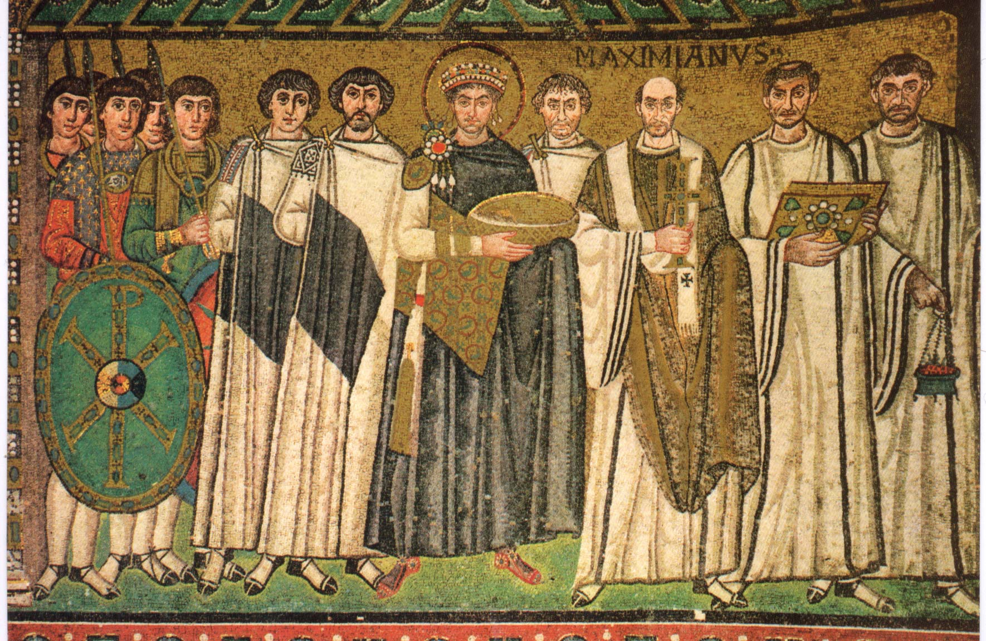
Portrait Mosaic of Justinian, Church of San Vitale, Ravenna, Italy c.530CE

Slide 17
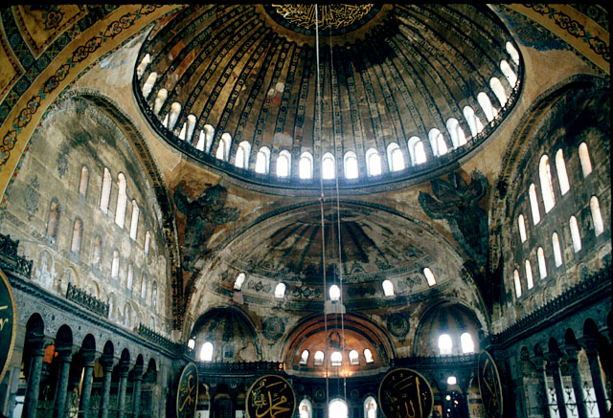
HAGIA SOPHIA Byzantine Cathedral
Constantinople, now Istanbul, Turkey

Slide 18
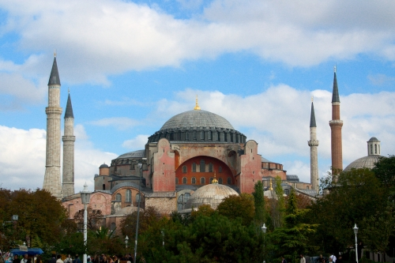
HAGIA SOPHIA Byzantine Cathedral
Constantinople, now Istanbul, Turkey

Slide 19
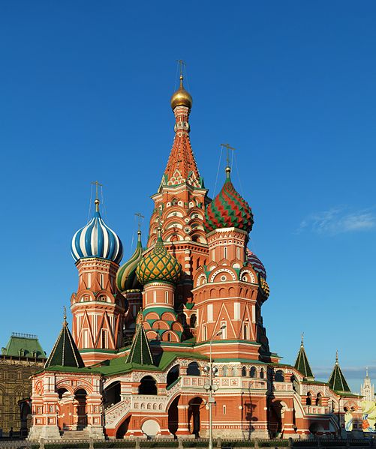
St Basil’s Cathedral
Moscow
Onion dome - A dome that bulges in the middle and rises to a point, used esp. in Russian church architecture.

Slide 20
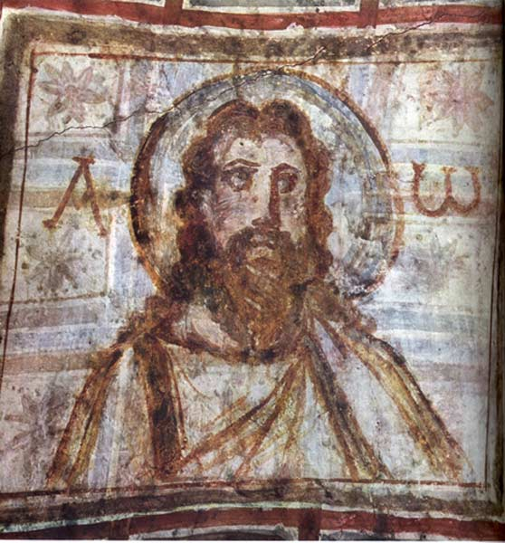
Iconoclasm – from 726-843ce
Icons (from the Greek eikones) are sacred images representing the saints, Christ, and the Virgin, as well as narrative scenes such as Christ's Crucifixion. While today the term is most closely associated with wooden panel painting, in Byzantium icons could be crafted in all media, including marble, ivory, ceramic, gemstone, precious metal, enamel, textile, fresco, and mosaic.
Old Testament prohibitions against worshipping graven images (Exodus 20:4) provided one of the most important precedents for Byzantine Iconoclasm.
Christ Pantocrator (The Ruler of the Universe), Catacombs of Commodilla, 4th century

Slide 21
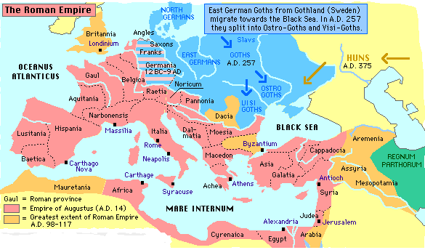
Migration Period Art
As elsewhere in Europe between 1 and 500, the Roman empire was the power against which peoples outside its borders defined themselves. By the end of the period, migrating tribes caused violent disturbances in the social fabric. metmuseum.org

Slide 22
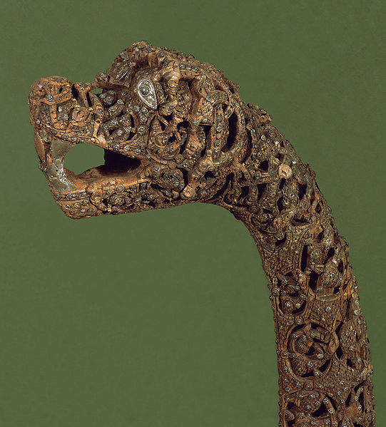
Viking carved wood and metal prow from the Oseberg ship, ca. 800, Norway

Slide 23
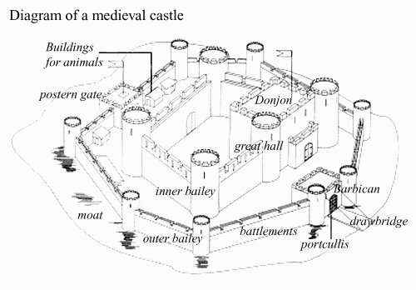
http://www.abdn.ac.uk/english/lion/castles.shtml

Slide 24
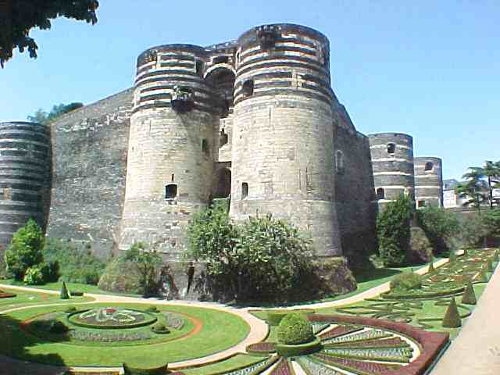
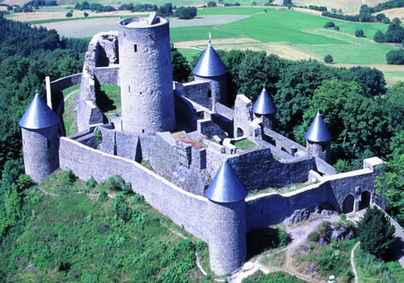
The medieval castle originated in the ninth century in France, western Germany and northern Italy because the nobles began building fortifications in response to increasing insecurity in the region.
France
In Europe in the Middles Ages the castle was a fortified residence of a nobleman, effectively displaying his authority and feudal lordship over the territory associated with it as well as serving a military function. The castles were sometimes fortified towns with a fortified bridge which was very important against the defense of the Vikings.
Germany

Slide 25
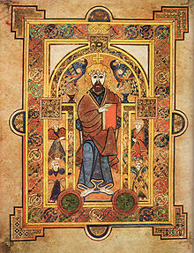
Insular Art –
(“insula” is Latin for island)
This is art produced on the British Isles after Roman rule. It is part of the Migration Period.

Slide 26
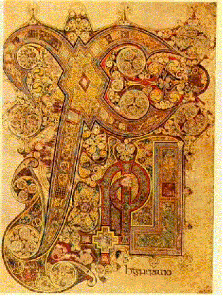
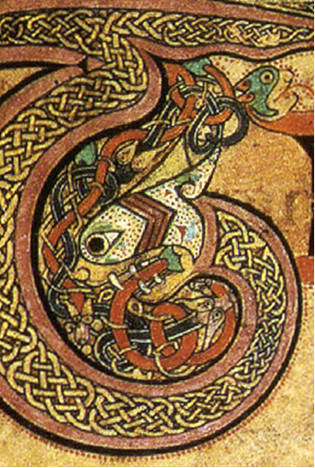
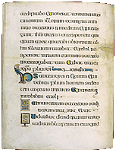
The origin of the Book of Kells (as with much in history) is debated, but there is strong evidence that the original work began in the Iona Monastery in Scotland by the Irish under the commission of, or by, St. Columba of the Collum Cillae order. As for the number of scribes involved, there is a consensus that there was a minimum of two main scribes with speculation that there may have been as many as 30 subordinate scribes contributing. Regardless of the number of scribes involved, it is estimated that it took no less that thirty years to complete.
http://www.regent.edu/general/library/about_the_library/news_publications/2006_03.cfm

Slide 27
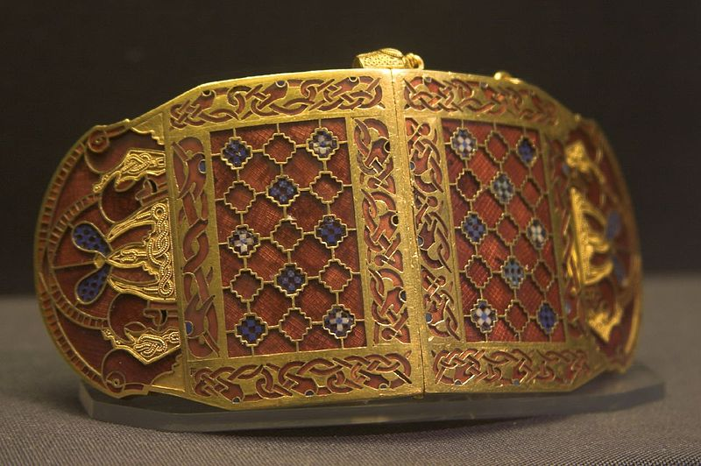
Shoulder-clasp from Sutton Hoo, early 7th century Anglo-Saxon. The interlaced biting snakes and confronted boars (end sections) are depicted entirely schematically. Rædwald of East Anglia the presumed recipient of the Sutton Hoo burial had been baptised, but maintained a pagan altar to please his wife

Slide 28
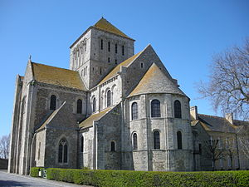
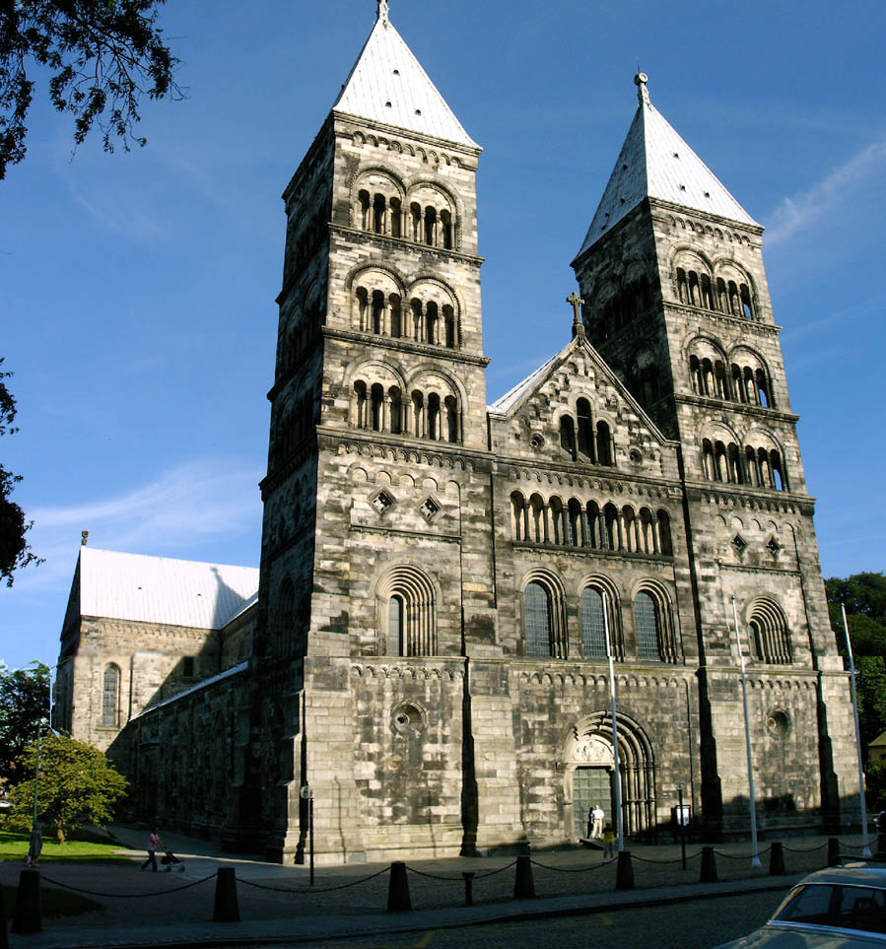
Romanesque Art
A style of architecture and art common in Europe between the ninth and twelfth centuries. It combined elements of the architecture typical of the Roman Empire and the Byzantine Empire. The arches on Romanesque buildings are usually semicircular rather than pointed as in Gothic architecture. Read more: http://www.answers.com/topic/romanesque#ixzz2E1kc1bLk

Slide 29
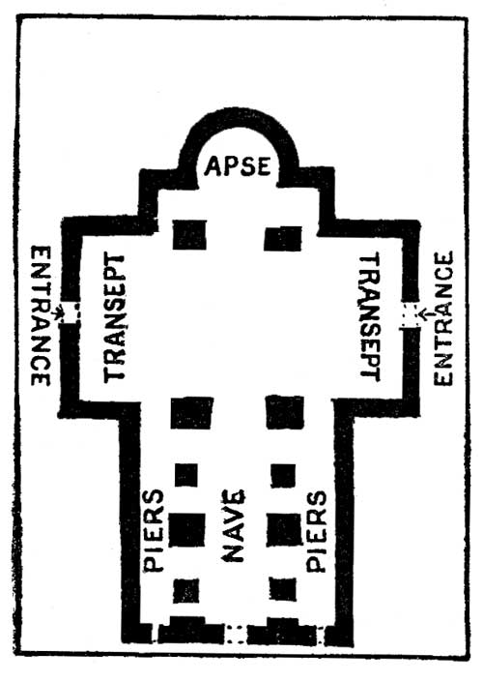
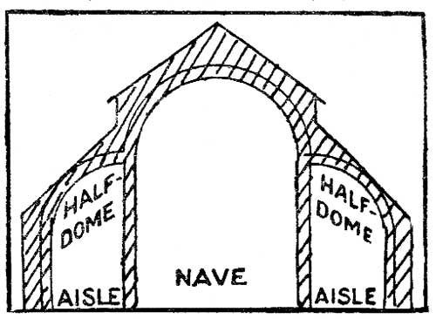

Slide 30
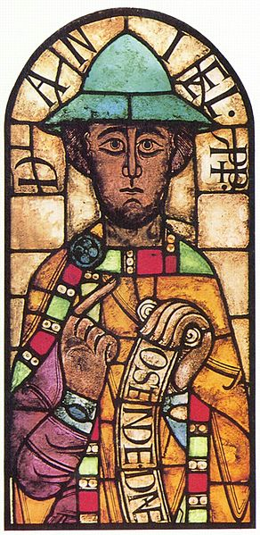
Stained glass, the Prophet Daniel from Augsburg Cathedral, late 11th century

Slide 31
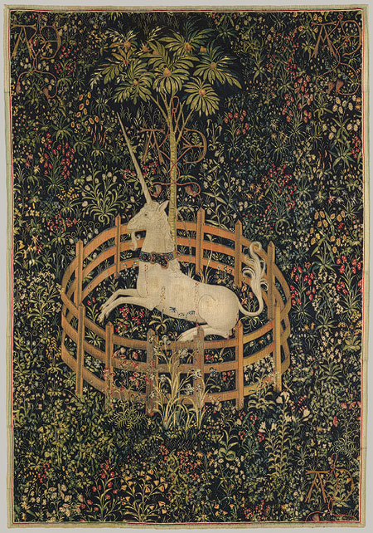
Gothic Art -
Of or in the style of architecture prevalent in western Europe in the 12th–16th centuries, characterized by pointed arches, rib vaults, and flying buttresses, together with large windows and elaborate tracery
The Unicorn in Captivity, ca. 1495–1505 South Netherlandish Wool warp, wool, silk, silver, and gilt wefts 12 ft. 1 in. x 99 in. (368 m x 251.5 cm) Gift of John D. Rockefeller Jr., 1937 (37.80.6)

Slide 32
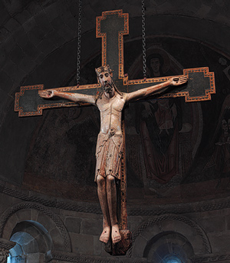
Crucifix, second half of 12th century Spanish; Said to be from the convent of Santa Clara de Astudillo, Palencia Cross: red pine, polychromy, textured gilt, and glass; Christ: white oak and polychromy H. 102 1/2 x 81 3/4 in. (260.4 x 207.6 cm)

Slide 33
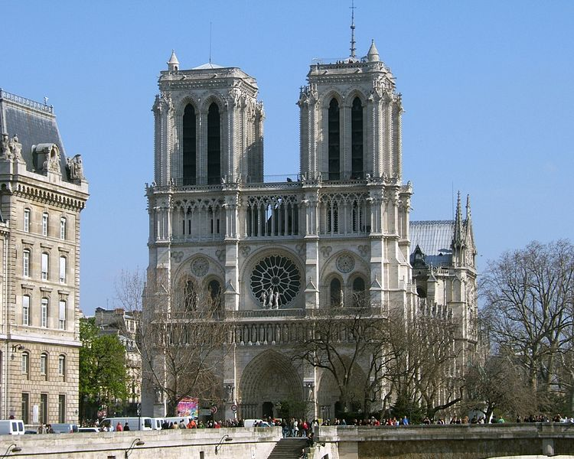
Architectural style | French Gothic
Direction of façade | West
Groundbreaking | 1163 (1163)
Completed | 1345

Slide 34
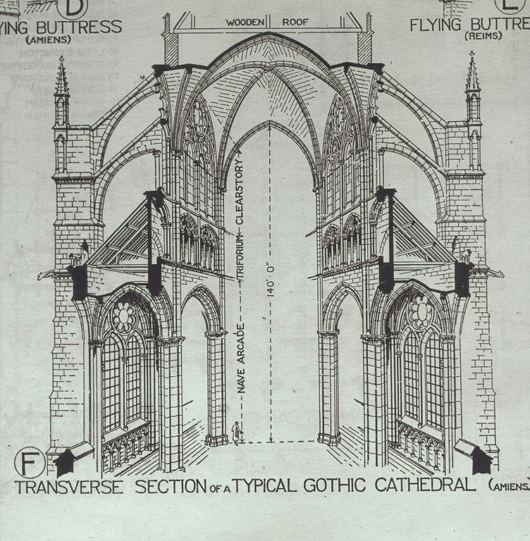

Slide 35
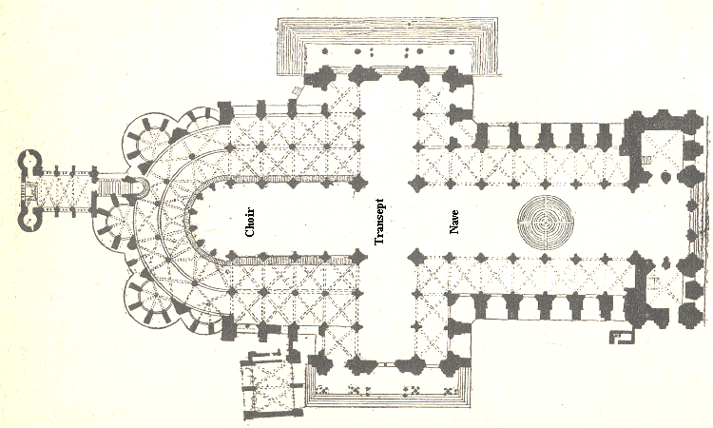

Slide 36
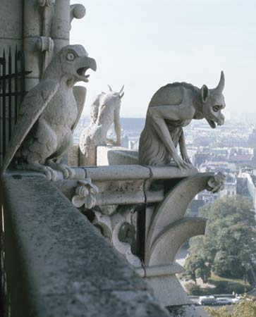
The original purpose of a gargoyle was to drain water away from the sides of a building. The word comes from the French "gargouille" which means "throat or pipe." Many gargoyles fill this purpose, but others are purely decorative.The images may relate to Europe's pagan past, combining various animal parts in a grotesque fashion. One possible purpose for them is the belief that frightening figures could scare away evil spirits. Another theory is that they are reminders of the fate of sinners.

Slide 37
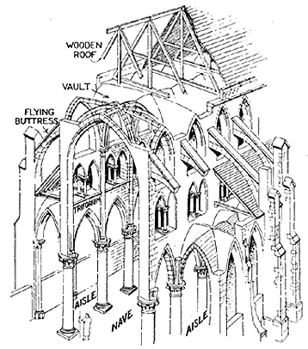

Slide 38
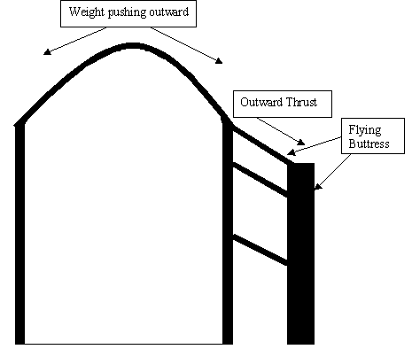
Gothic architecture has three distinct characteristics which set it apart from Romanesque; pointed arches, ribbed vault, and flying buttresses. These developments allowed the architects to make the church much larger and brighter. By transferring the weight of the ceilings outward thrust to the flying buttresses, they were now able to place huge stain glass windows in the walls. this allowed the once dim Romanesque Cathedral to be transformed into a very bright and warm feeling Gothic Cathedral. These churches also reflect the wealth and influence of the church in the Middle Ages. Many of these churches and cathedrals took over a century to build.
Pictures which follow 1)Flying Buttress 2)Flying Buttress 3)Pointed Arch 4)Spires 5)Gothic Cathedral
6)Gothic Cathedral Hallway

Slide 39
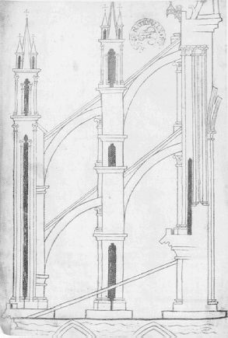
Flying Buttresses
Buttress
If it has flying buttresses, pointed arches, and rose windows, it’s Gothic.

Slide 40
Notre Dame, Paris c. 1163-1250.

Slide 41
Notre Dame, Paris c. 1163-1250.

Slide 42
Notre Dame Cathedral
Paris, France

Slide 43
Rose window, Notre Dame Cathedral

Slide 45
High Gothic period of cathedral building spans the twelfth and thirteenth centuries, and is especially concentrated in Paris and surrounding cities. The most famous Gothic cathedrals are those at Paris (from 1163), Reims (from 1165) and Chartres (from 1194).

Slide 46
Originally consecrated in 1063, Rouen Cathedral was replaced after a devastating fire in 1200; only the left-hand spire survived the flames. Construction on the imposing 250-ft steeple on the right, known as the Tour de Beurre (Butter Tower), was begun in the 15th century and completed in the 17th, when a group of wealthy citizens donated large sums of money for the privilege of continuing to eat butter during Lent.
A masterpiece of lacy stonework, Rouen cathedral is topped by the aforementioned Tour de Beurre and the Tour Lanterne (Lantern Tower), which contains a carillon of 56 bells, utilizes 740 tons of iron and bronze, and rises to almost 150m (500 ft.).

Slide 47
Ideal Gothic Church Viollet-le-Duc

Slide 49
Vocabulary
Medieval – of or pertaining to the Middle Ages
Dark Ages - The period in western Europe between the fall of the Roman Empire and the high Middle Ages, c.ad 500–1100, during which Germanic tribes swept through Europe and North Africa, often attacking and destroying towns and settlements
Byzantine -Of an ornate artistic and architectural style that developed in the Byzantine Empire and spread esp. to Italy and Russia. The art is generally rich and stylized (as in religious icons) and the architecture typified by many-domed, highly decorated churches
Gothic - Of or in the style of architecture prevalent in western Europe in the 12th–16th centuries, characterized by pointed arches, rib vaults, and flying buttresses, together with large windows and elaborate tracery
Romanesque - a style of architecture developed in Italy and western Europe between the Roman and the Gothic styles after 1000 AD; characterized by round arches and vaults and by the substitution of piers for columns and profuse ornament and arcades
Vault - A roof in the form of an arch or a series of arches, typical of churches and other large, formal buildings
Tesserae - A small block of stone, tile, glass, or other material used in the construction of a mosaic.
Buttress - A projecting support of stone or brick built against a wall.

